Slide 1
Onboarding merchants at NETS
Name: Lucas, Ashley, Adlina, Avryl
Team ID: SOI-2024-0018
Project ID: SOI-2024-2420-0047

Slide 2
Table of contents
Introduction of project
Diagrams
01
02
Application Demo
Conclusions
03
04
Details about the project
ERD Diagram, UCD Diagram
Demonstrating how the website works
Summary

Slide 3
Introduction
Our project is about aiming to solve the issue of inefficiencies in the merchant onboarding procedure of the NETS system. Now, the onboarding procedure is time-consuming and manual, which slows down workflow and raises the possibility of human error. Thus, the project's goal is to use an API to automatically retrieve merchant data straight from the Accounting and Corporate Regulatory Authority (ACRA) to address this issue. This method offers a more efficient, quicker, and more precise approach, improving the onboarding process for both merchants and NETS. The motivation behind this project is to improve the merchant onboarding process's operational efficiency. By cutting down on manual data entry and processing delays, NETS can improve overall data accuracy by accelerating the onboarding of new merchants and lowering data handling errors. This includes a number of important tasks and deliverables, such as creating a secure digital signing procedure, utilizing the data to create the required onboarding documents, and integrating an API with ACRA to get relevant merchant data. By doing these actions, the project offers an onboarding solution that complies with security standards and is accurate and automated.

Slide 4
Diagrams Showcase

Slide 5
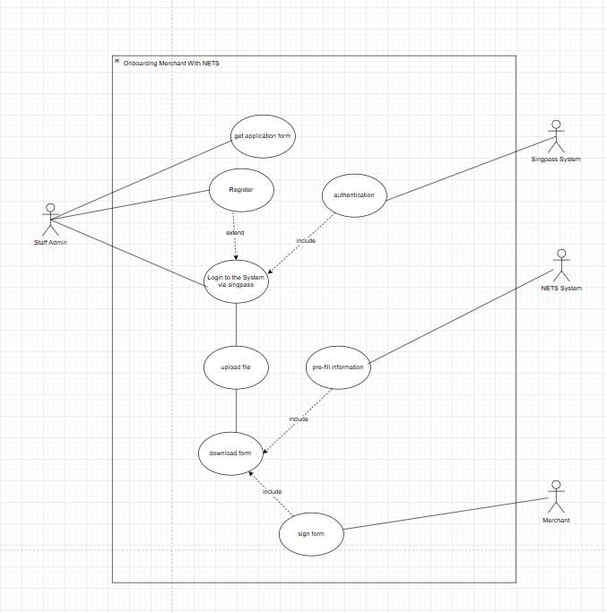
User Case Diagram

Slide 6
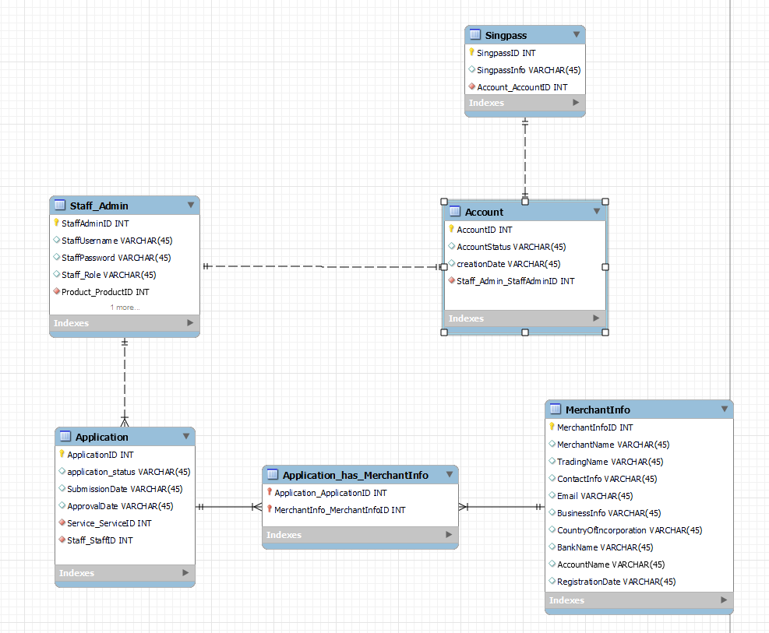
ERD Diagram

Slide 7
Application Demo

Slide 8
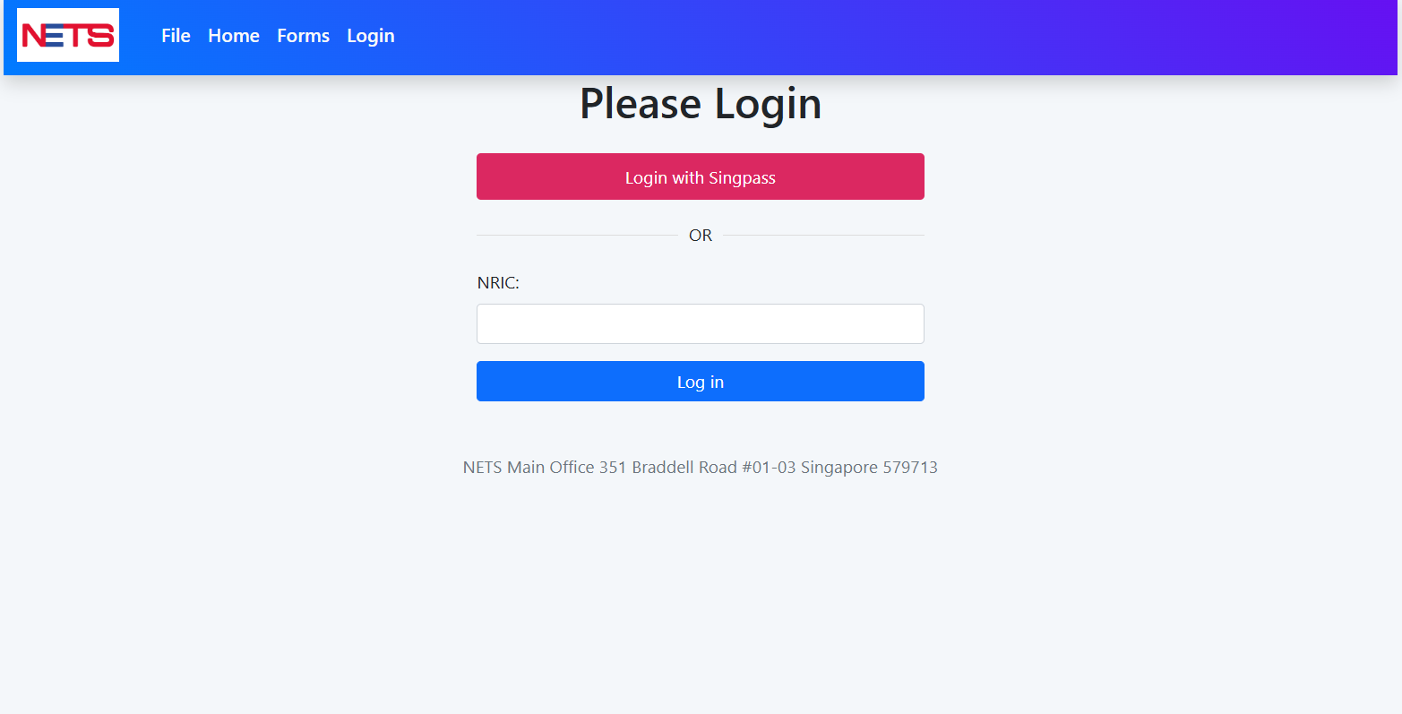
Login Page

Slide 9
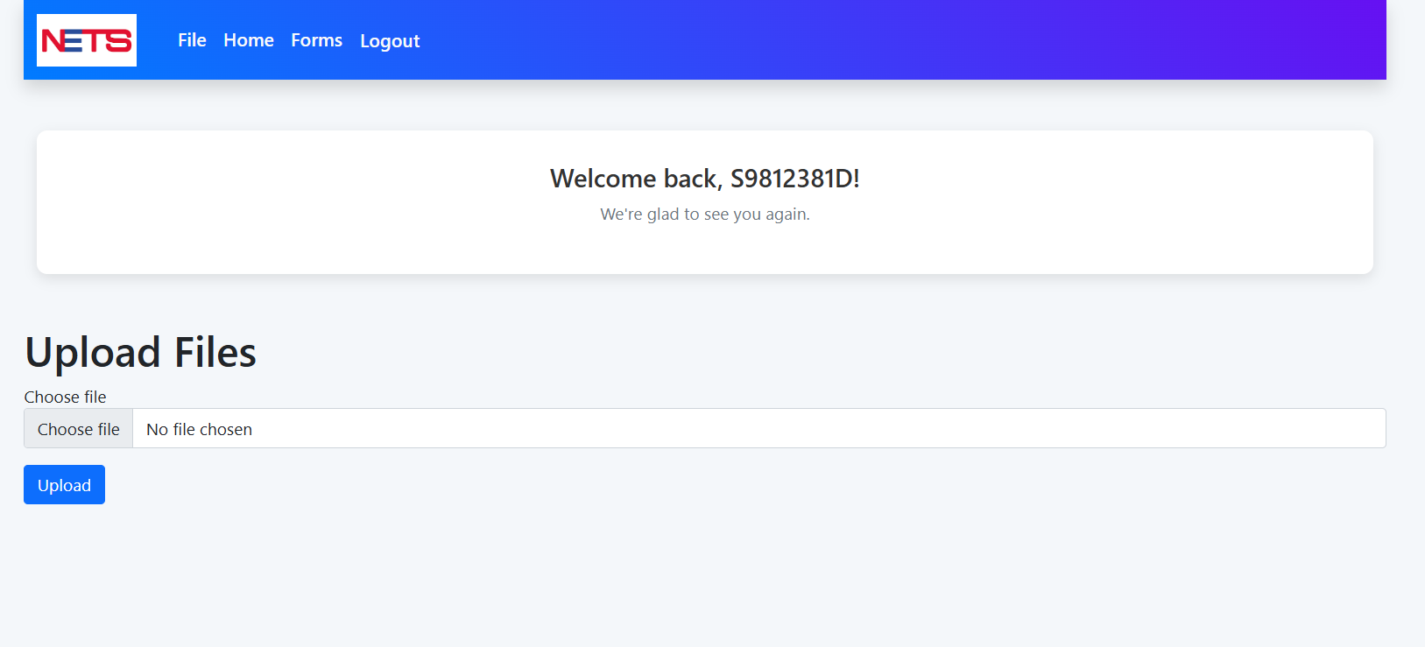
Uploading File Page

Slide 10
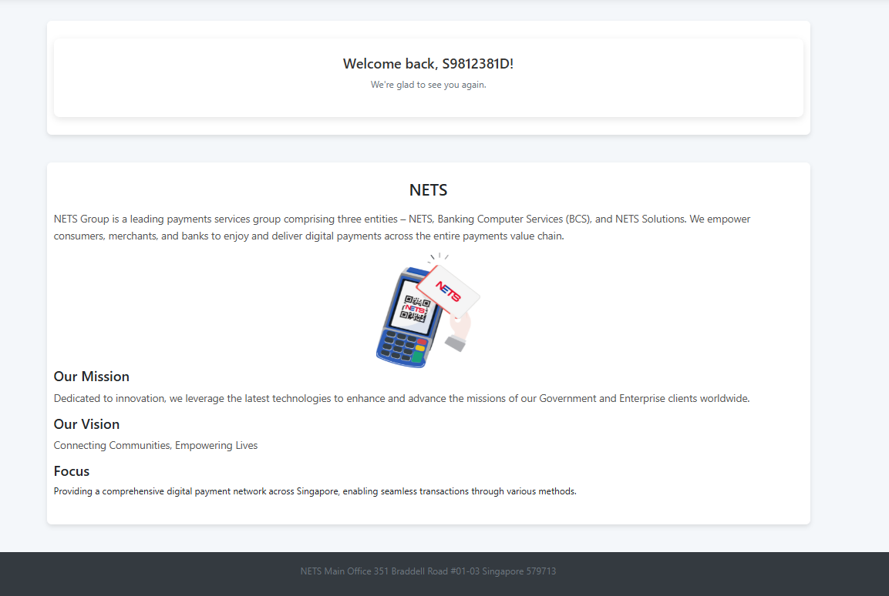
Home Page

Slide 11
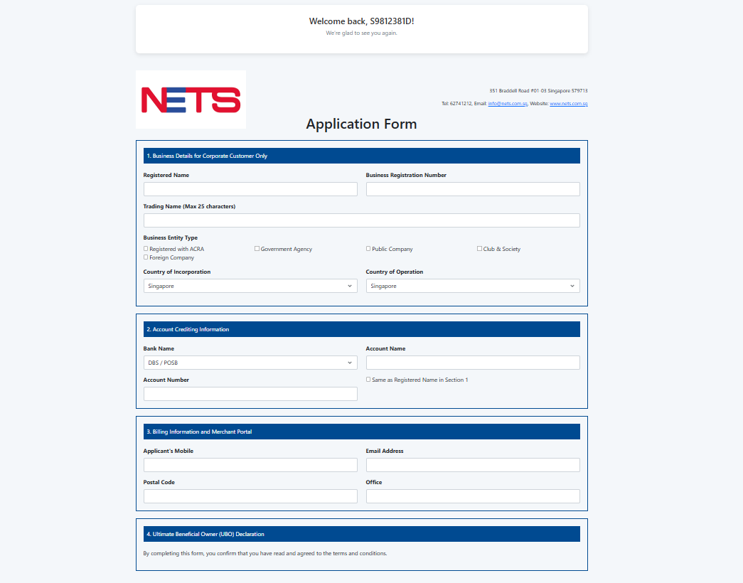
Application Forms Page

Slide 12
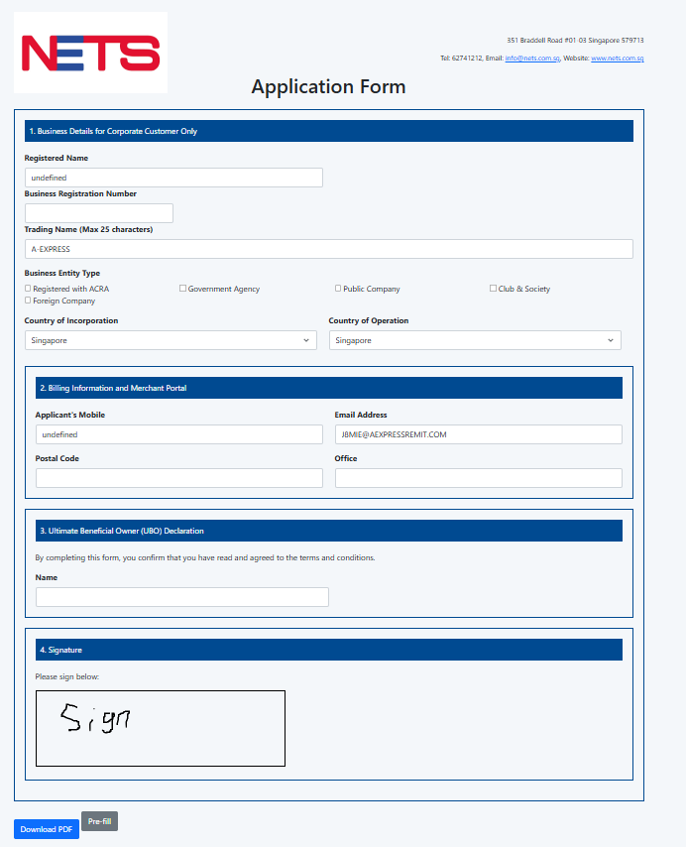
PRE-FILL & SIGN

Slide 13
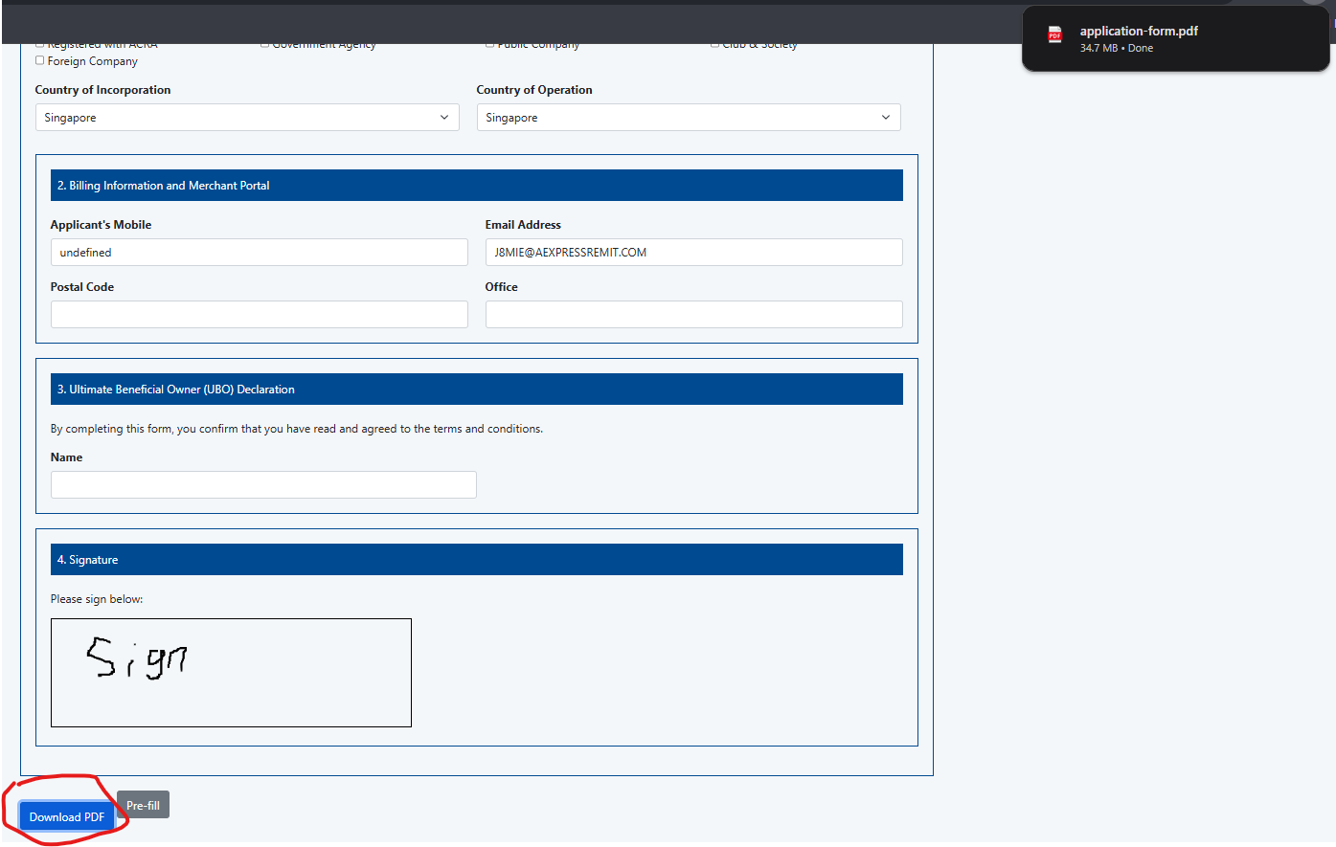
download

Slide 14
Conclusion

Slide 15
Our Final Words
To sum it up, this project's aim is to reduce manual data as well as processing delays, making it easier for NETS to process merchants' application forms and improving data accuracy of the onboarding process. This project has been a wild ride for all of us as we get to explore different parts of the project, such as figuring out how to get the extraction of data and SingPass login work, and collaborate as a team to come up with a solution that will help NETS improve the merchant onboarding process. Below are each of our final summaries:
Lucas: This project has finally come to an end and I felt relieved and somewhat proud of the work we came up with. Even though there were not much progress at the start, we still manage to make some parts of the project work at the end and even though this project caused so much stress on all of us. This project also taught me the importance of teamwork and collaboration, which can be very important when it comes to teamwork and I am glad we survived till the very end as one team
Ashley: Our Final Year Project (FYP) was truly an eye-opening experience for us. It was unlike anything we had encountered before, presenting new challenges that tested our skills, patience, and teamwork. Despite the unfamiliarity and obstacles we faced, we came together as a team, leveraging each other's strengths and supporting one another through difficult moments. Through collaboration, perseverance, and shared determination, we managed to push through, growing both individually and collectively. This journey not only strengthened our technical and problem-solving abilities but also reinforced the importance of teamwork and resilience in achieving our goals.
Adlina: In my opinion, initially the progress of the team is slow as we all were getting used to it but slowly, we managed to keep up with the pace, created the diagrams, did our research and our parts for the project before coming together to integrate into a single work. It is definitely not an easy task when working alone, but it became manageable as everyone in the team played the part well. Through this project, I learnt that constant communication and teamwork is crucial to succeed.
Avryl: Finally we have come to the end for this project, I'm glad that we worked together as a team to come up with something that we are all proud of. This project is not easy but we stayed strong and tried our best to present something that is of quality. Teamwork and resilience is the way to succeed and produce something of quality.

Slide 16
Q&A

Slide 17
Thank you!

